Slide 1

Data Capstone Project Analytics for Data Breaches – Model Building & Evaluation
presented by
Miriam Rodriguez

Slide 2
Purpose
Determine the best data model to use to predict:
The type of breach that can occur in an organization (look at trends).
Which organizations are most vulnerable
Likelihood of a specific type of breach

Slide 3
Modeling Approach
Look at a variety of modeling approaches:
Unsupervised machine learning
Supervised machine learning - Classification
Linear regression and Logistic regression
Adjust and finalize the model(s) that fits the data.
Fit the data into that model to answer business questions.

Slide 4
Supervised Text Classification Modeling - Descriptions
Used Breach Type as Classifier
Processed Descriptions from Privacy File
Preprocessing and feature engineering (Words to Vectors)
Model Building, Validation, Evaluation using Split Validation, Grid Search, Cross Validation
Used a variety of classifiers

Slide 5
Classification Models Utilized for Text processing
Naive Bayes Multinomial
kNeighbors Classifier (kNN)
SVM (Support Vector Machine)
0.63691931540342295
0.68052159739201301
0.783211083945
Models
Overall Accuracy

Slide 6
Classification Models Utilized for Text processing Adjustments to Improve Models
Naive Bayes Multinomial
Removed Stop Words
After Grid Search-no adjust
Cross-Validation 10 fold
After Grid Search – new parameters
kNeighbors Classifier (kNN)
Not able to improve
SVM (Support Vector Machine)
Not able to improve
0.66462917685411571
0.72290138549307248
0.717871168729 0.68581907090464544
0.68052159739201301
0.783211083945
Models
Overall Accuracy

Slide 7
Classification Report: for Naïve Bayes
precision recall f1-score support
CARD 0.00 0.00 0.00 18
DISC 0.78 0.30 0.43 504
HACK 0.59 0.93 0.72 746
INSD 0.83 0.21 0.34 165
PHYS 0.61 0.80 0.69 523
PORT 0.77 0.75 0.76 351
STAT 0.00 0.00 0.00 73
UNKN 0.00 0.00 0.00 74
avg / total 0.63 0.64 0.59 2454

Slide 8
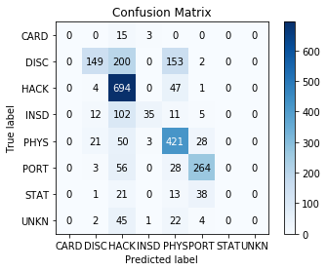
Naïve Bayes Confusion Matrix
Overall accuracy = 0.636919315403
Highest accuracy shows 'Hack' with 694 correct classifications
Next highest is 'Phys' with 421 correct classifications, then 'PORT' with 264.
200 were miscalculated as Hack when they should have been DISC. 153 were mis-categorized as 'PHYS' when should be 'DISC'.

Slide 9
Fit Data to SVM model/Classification Report
precision recall f1-score support
CARD 0.67 0.44 0.53 18
DISC 0.71 0.70 0.71 504
HACK 0.83 0.87 0.85 746
INSD 0.84 0.77 0.80 165
PHYS 0.74 0.82 0.78 523
PORT 0.84 0.90 0.87 351
STAT 0.73 0.52 0.61 73
UNKN 0.67 0.05 0.10 74
avg / total 0.78 0.78 0.77 2454

Slide 10
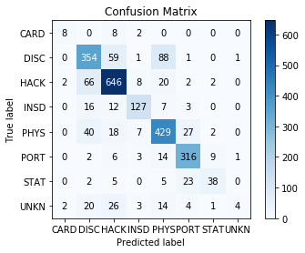
SVM Confusion Matrix
Overall accuracy = 0.783211083945
Highest accuracy shows 'Hack' with 646 correct classifications
Next highest is 'Phys' with 429 correct classifications, then 'DISC' with 354 and PORT with 316.

Slide 11
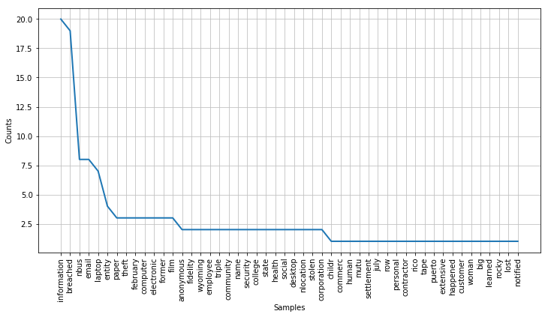
Unsupervised -Data Preprocessing and Results
Conducted word frequency analysis

Slide 12
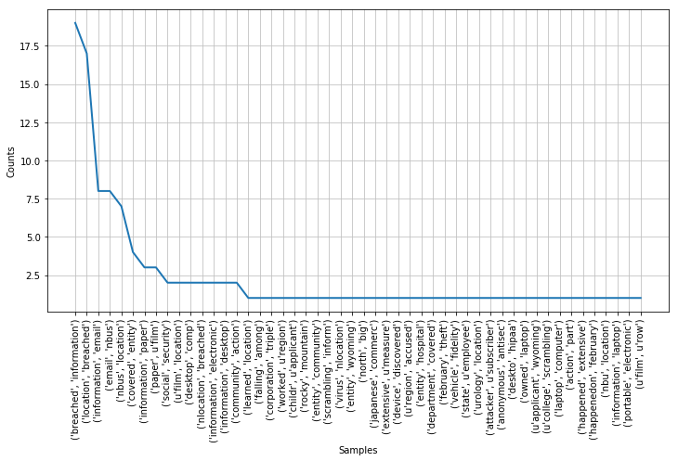
Unsupervised -Data Preprocessing and Results
Results Bigram Word Frequency Analysis

Slide 13
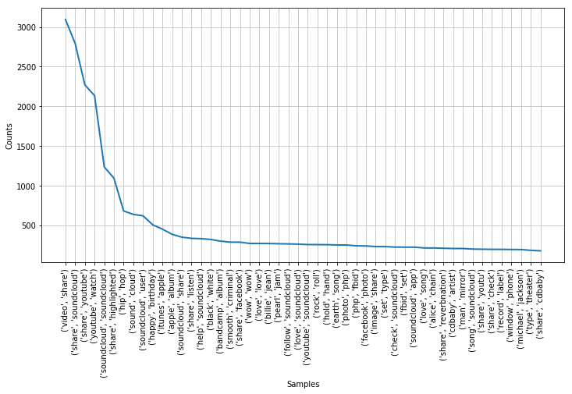
Methods and Results- bigrams

Slide 14
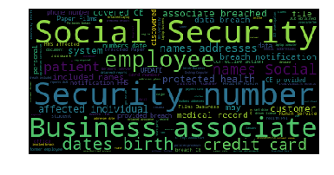
Unsupervised – Word Cloud Analysis
The themes here appear to be social security number, credit cards, birthdates, names and addresses, employees and business associates.

Slide 15
Methods/Results – LDA Topic Modeling
Assign the topics to the documents in corpus (Document-Topic Distribution)
After Top 10 topics show persistent cases of physical loss and theft and hacking.¶
Used 15 for the number of topics.
Used pyLDAvis to generate a Intertopic Distance Map.
Top topics appear to be related to
Phishing attacks through Email
Credit Card breaches at point of sale (i.e. Restaurants
Credit/Cards, bank accounts
Facebook, online, downloads

Slide 16
Top Topics from LDA Model
1) Hacking getting email, passwords, etc.
2) Credit card and bank accounts, lawsuit
3) Unauthorized access to payment systems
4) University, student, computer files, documents
9) Stolen laptop from employee containing patient medical information, birthdate, etc.

Slide 17
Top Topics from LSI Model
Similar to LDA only in different order and less clear
1) Breaches relating to business and servers.
2) Stolen laptop from employee containing patient medical information.
3) Breaches related to email
LSI shows topics that appear similar, harder to differentiate topics. Prefer LDA topic model.

Slide 18
Conclusion
For unsupervised topic modeling, prefer LDA
For supervised classification models for description data, will use SVM model
For supervised classification models for non-description data, will use Random Forest.

